Slide 1
Ensuring WMO Construction Compliance
MWRD Local Sewers Section
Notes:
If your presentation title has a subtitle, use this slide..

Slide 2
What is the Watershed Management Ordinance (WMO)?
Notes:
Section Title

Slide 3

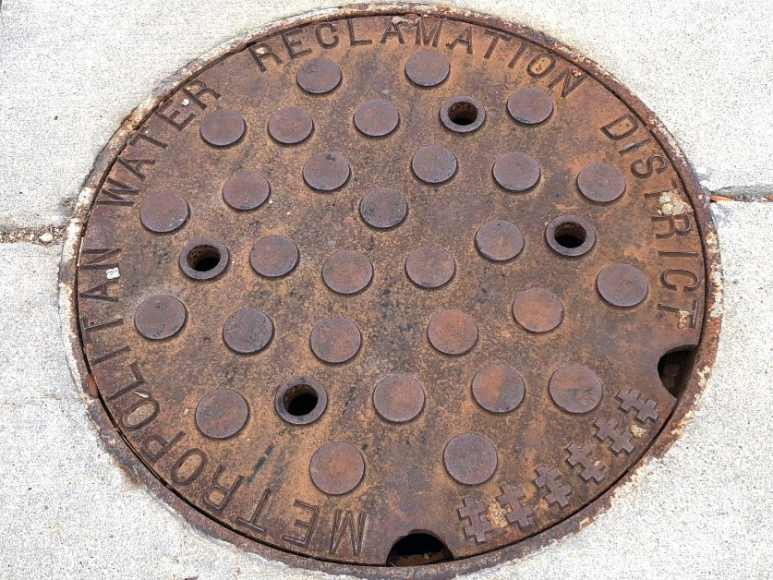
WMO Background
The Watershed Management Ordinance (WMO) went into effect on May 1, 2014. The WMO applies to all development within the boundaries of Cook County and qualified sewer construction within the MWRD’s corporate boundaries or service agreement areas. It regulates qualified sewer construction drainage and detention, volume control, floodplain management, isolated wetland protection, riparian environment protection, and soil erosion and sediment control.
Notes:
Added slide

Slide 4
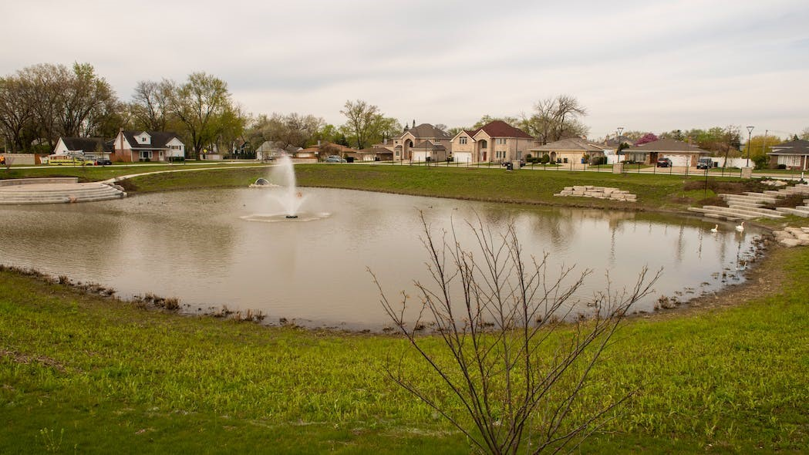

WMO Purpose & Goals
Some of the WMO’s purposes are to:
Protecting the public health, safety, and welfare, and reducing potential for loss of property due to flood damage
Managing and mitigating the effects of urbanization on stormwater drainage throughout Cook County
Protecting existing and new development by minimizing the increase of stormwater runoff volume beyond that experienced under existing conditions and by reducing peak stormwater flows
Reducing or mitigating the environmentally detrimental effects of existing and future runoff in order to improve and maintain their beneficial functions
A full list of the WMO’s purpose and the full ordinance document can be found in the following website:
https://mwrd.org/watershed-management-ordinance-information
Notes:
Added slide

Slide 5
Protecting the public health, safety, and welfare, and reducing the potential for loss of property due to flood damage
In general, a permit will be required for the following type of work.
Development (grading, paving, excavation, etc.)
  Disturbances of more than 0.5 acres (some exemptions apply)
  Reconfiguration of existing stormwater systems which alter the service area of a site detention facility
  Modifications to a detention facility
Flood Protection Areas (floodway, floodplain, wetlands, riparian environments)
  Development within a Flood Protection Area, or an indirect impact to a wetland
  Activities with a direct wetland impact
  New buildings or foundation expansion that increases the footprint of the building by 2500 square feet or 20%, located in the regulatory floodplain
Qualified Sewer Construction (See Article 7 of the WMO)
MWRD Impacts
  Direct connections to an MWRD interceptor, reservoir, facility, or TARP structure
  New or reconstructed outfalls to waterways or Lake Michigan
Notes:
Exemptions include: agriculture, flood control projects, projects within the City of Chicago, projects that are regulated by multi-county municipalities

Slide 6
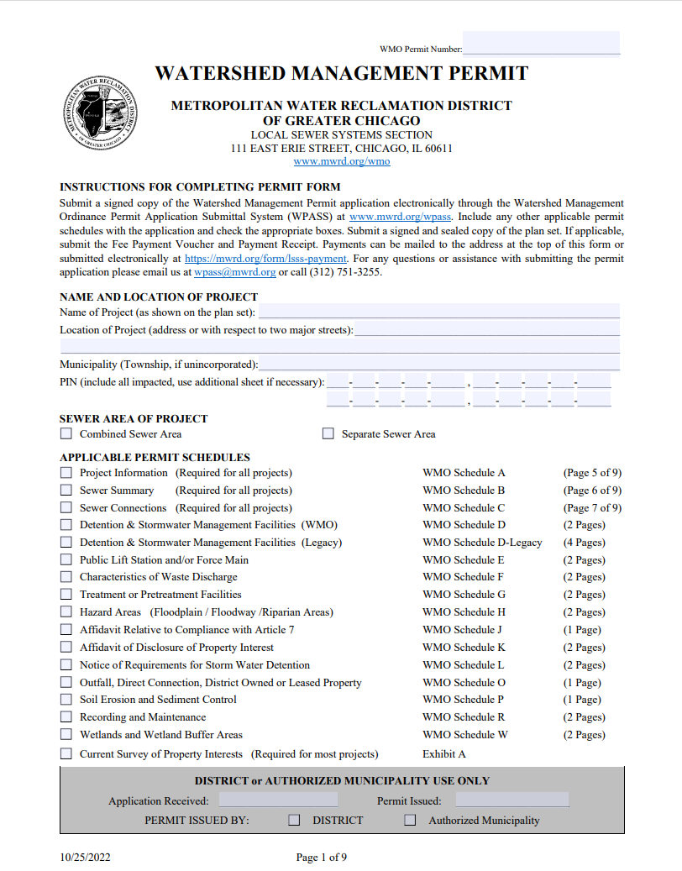
WMO permit review process
Design engineer submits permit application, supporting documents and fee (if applicable), through MWRD’s online submittal system.
MWRD assigns permit review engineer and permit number.
WMO allows 15 or 30 business days (the large amount of time is allowed for projects involving flood protection areas) for MWRD to respond with a review letter or issue the permit.
MWRD issues review letter to design engineer.
Design engineer responds with a resubmittal.
WMO allows 10 business days for MWRD to respond to resubmittals, or issue the permit.
Steps 4 and 5 repeat until permit review engineer determines that application fully complies with WMO.
Final review by the MWRD.
Permit is issued. Design engineer, Co-Permittee (property owner), Permittee (municipality) and MWRD Field Office are notified.
Notes:
Exemptions include: agriculture, flood control projects, projects within the City of Chicago, projects that are regulated by multi-county municipalities

Slide 7
Requirements once a WMO Permit is issued
Notes:
Section Title

Slide 8
Job Start Notification
We require two (2) days advance notification prior to the following milestones (typically by contractor):
After mobilization and installation of sediment control practices, prior to any soil disturbance
During excavation for the construction of qualified sewer construction
During construction of major stormwater systems and detention facilities
Contact: (708)-588-4055 (Field Office) or WMOjobstart@mwrd.org
Notes:
Section Content

Slide 9
MWRD Inspections
Construction in accordance with approved plans
1. Soil Erosion / Sediment Control measures:
  Silt fence, stabilized construction entrance, filter baskets, concrete washout
  Double row silt fence around floodplains, wetlands, riparian areas
2. Qualified sewer (sanitary sewer, combined sewer, or storm sewer in a combined sewer area)
  Pipe material, pipe joints, pipe bedding
  Watermain crossings
  Booted structures
  Plumber’s stub – no sch 40 solvent weld “glue” joints
3. Stormwater management facilities:
  Restrictor, debris hood, emergency overflow weir
  Volume control (stone, underdrains, fabric, media mix, plantings, signage)
Notes:
Section Content

Slide 10
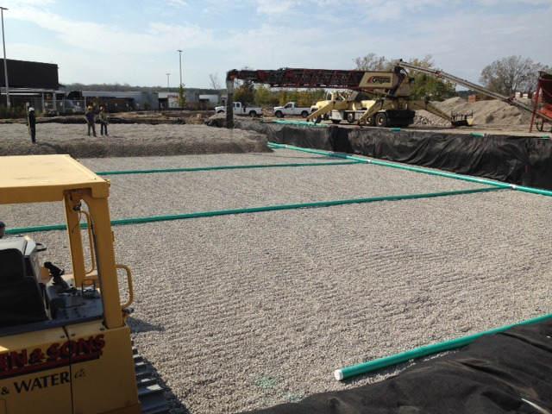

Slide 11
RFI’s (Request for Final Inspection)
Can be found online at https://mwrd.org/sites/default/files/documents/RFI_0.pdf
1. P.E. signature and seal required:
  Inspection Engineer
  Municipal Engineer (Village)
2. Signatures required
  Permittee
  General Contractor and owner (Co-Permittee)
3. Multiple RFI’s for some projects (more than one Permittee)
  Receiving sewer owned by another entity
  Project on border between multiple Villages
Notes:
Section Content

Slide 12
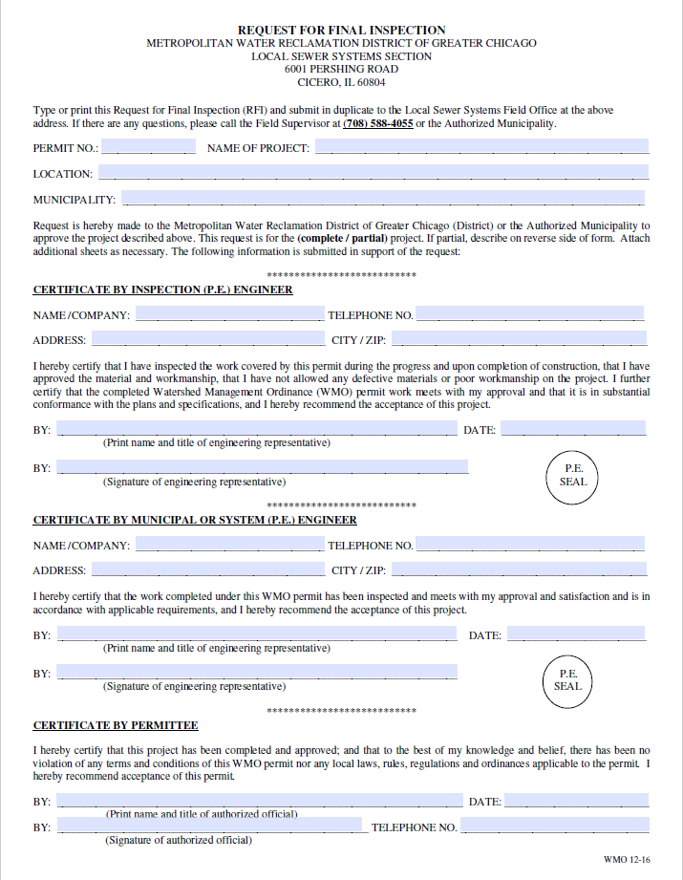
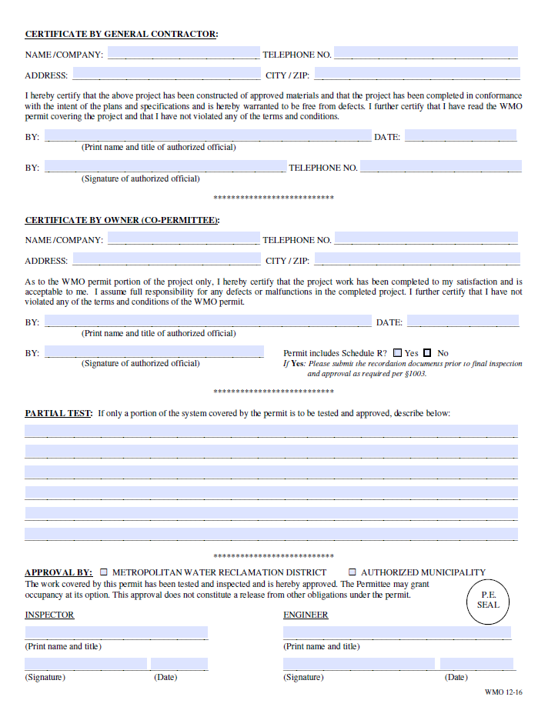

Slide 13
Record Drawings
We review and approve Record Drawings (document field changes)
1. Record Drawings must be signed and sealed by a PE or PLS:
2. Sewer
  Rim, inverts, pipe diameter, slope (utility plan)
3. Stormwater management facilities
  Grading plan
  Restrictor and overflow elevations
  Engineer must include calculations to document As-Built volume of detention and volume control and compensatory storage
Notes:
Section Content

Slide 14
Recording Schedule R
Recorded copy must be submitted to the MWRD
1. Recorded with the Cook County Recorder of Deeds against the PINs upon project completion
2. Provides notice of obligation to property owners that WMO permitted items shall be maintained
3. Return of $500 recordation fee deposit
4. Not required for municipal or ROW projects
Notes:
Section Content

Slide 15
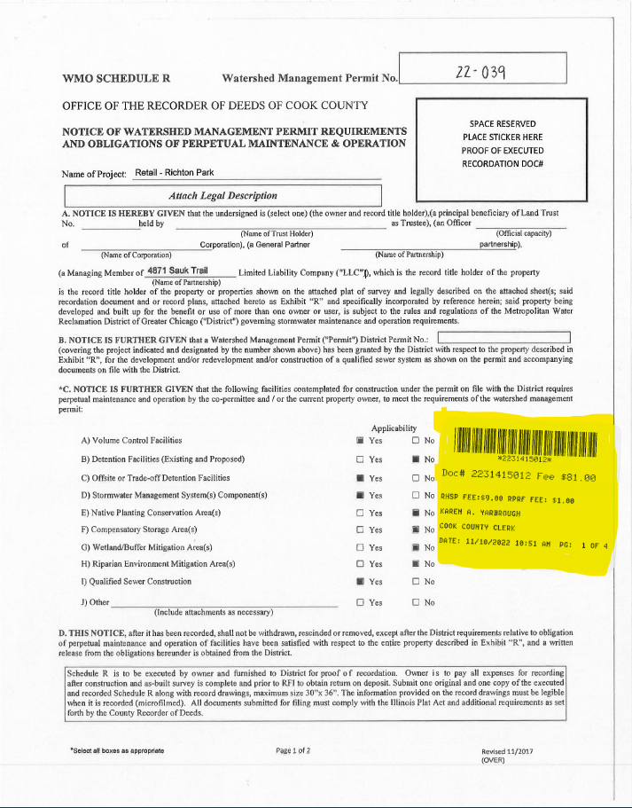
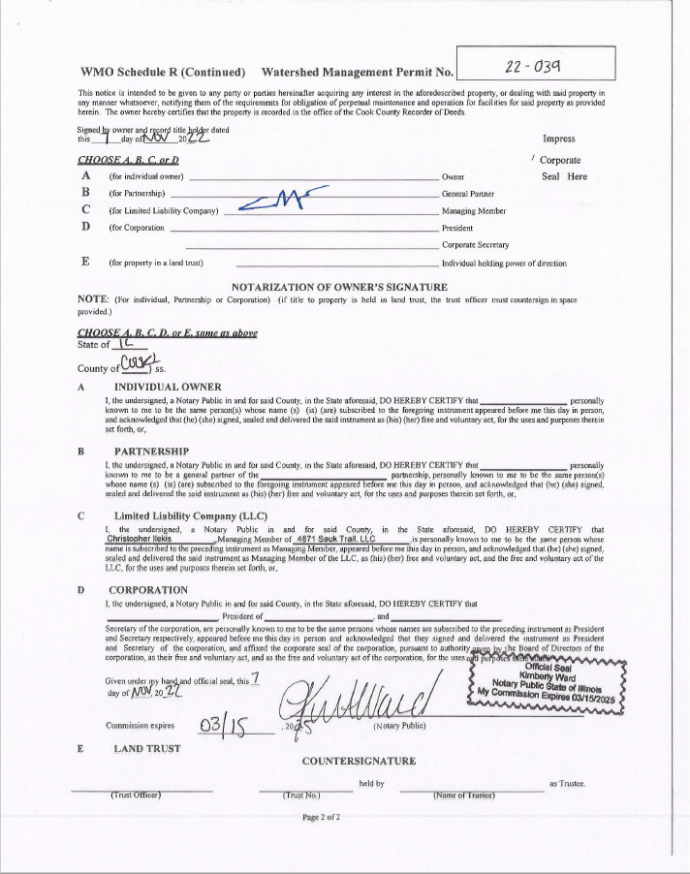

Slide 16
Final Inspection
Occurs at completion of project, prior to occupancy
All required documentation must be submitted prior to scheduling Final Inspection
  RFI, Record Drawings, Recorded Schedule R
2. Do not place the sewer into service prior to the Final Inspection (infiltration testing results)
3. Municipal employee and contractor shall be present
  Contractor shall open structures or provide lane closure if necessary
4. MWRD Testing Certificate
  Signed by all in attendance of Final Inspection (typically municipal employee, MWRD inspector and contractor)
  “Released” if the project passes inspection
  Shall be required for Village to grant Certificate of Occupancy
Notes:
Section Content

Slide 17
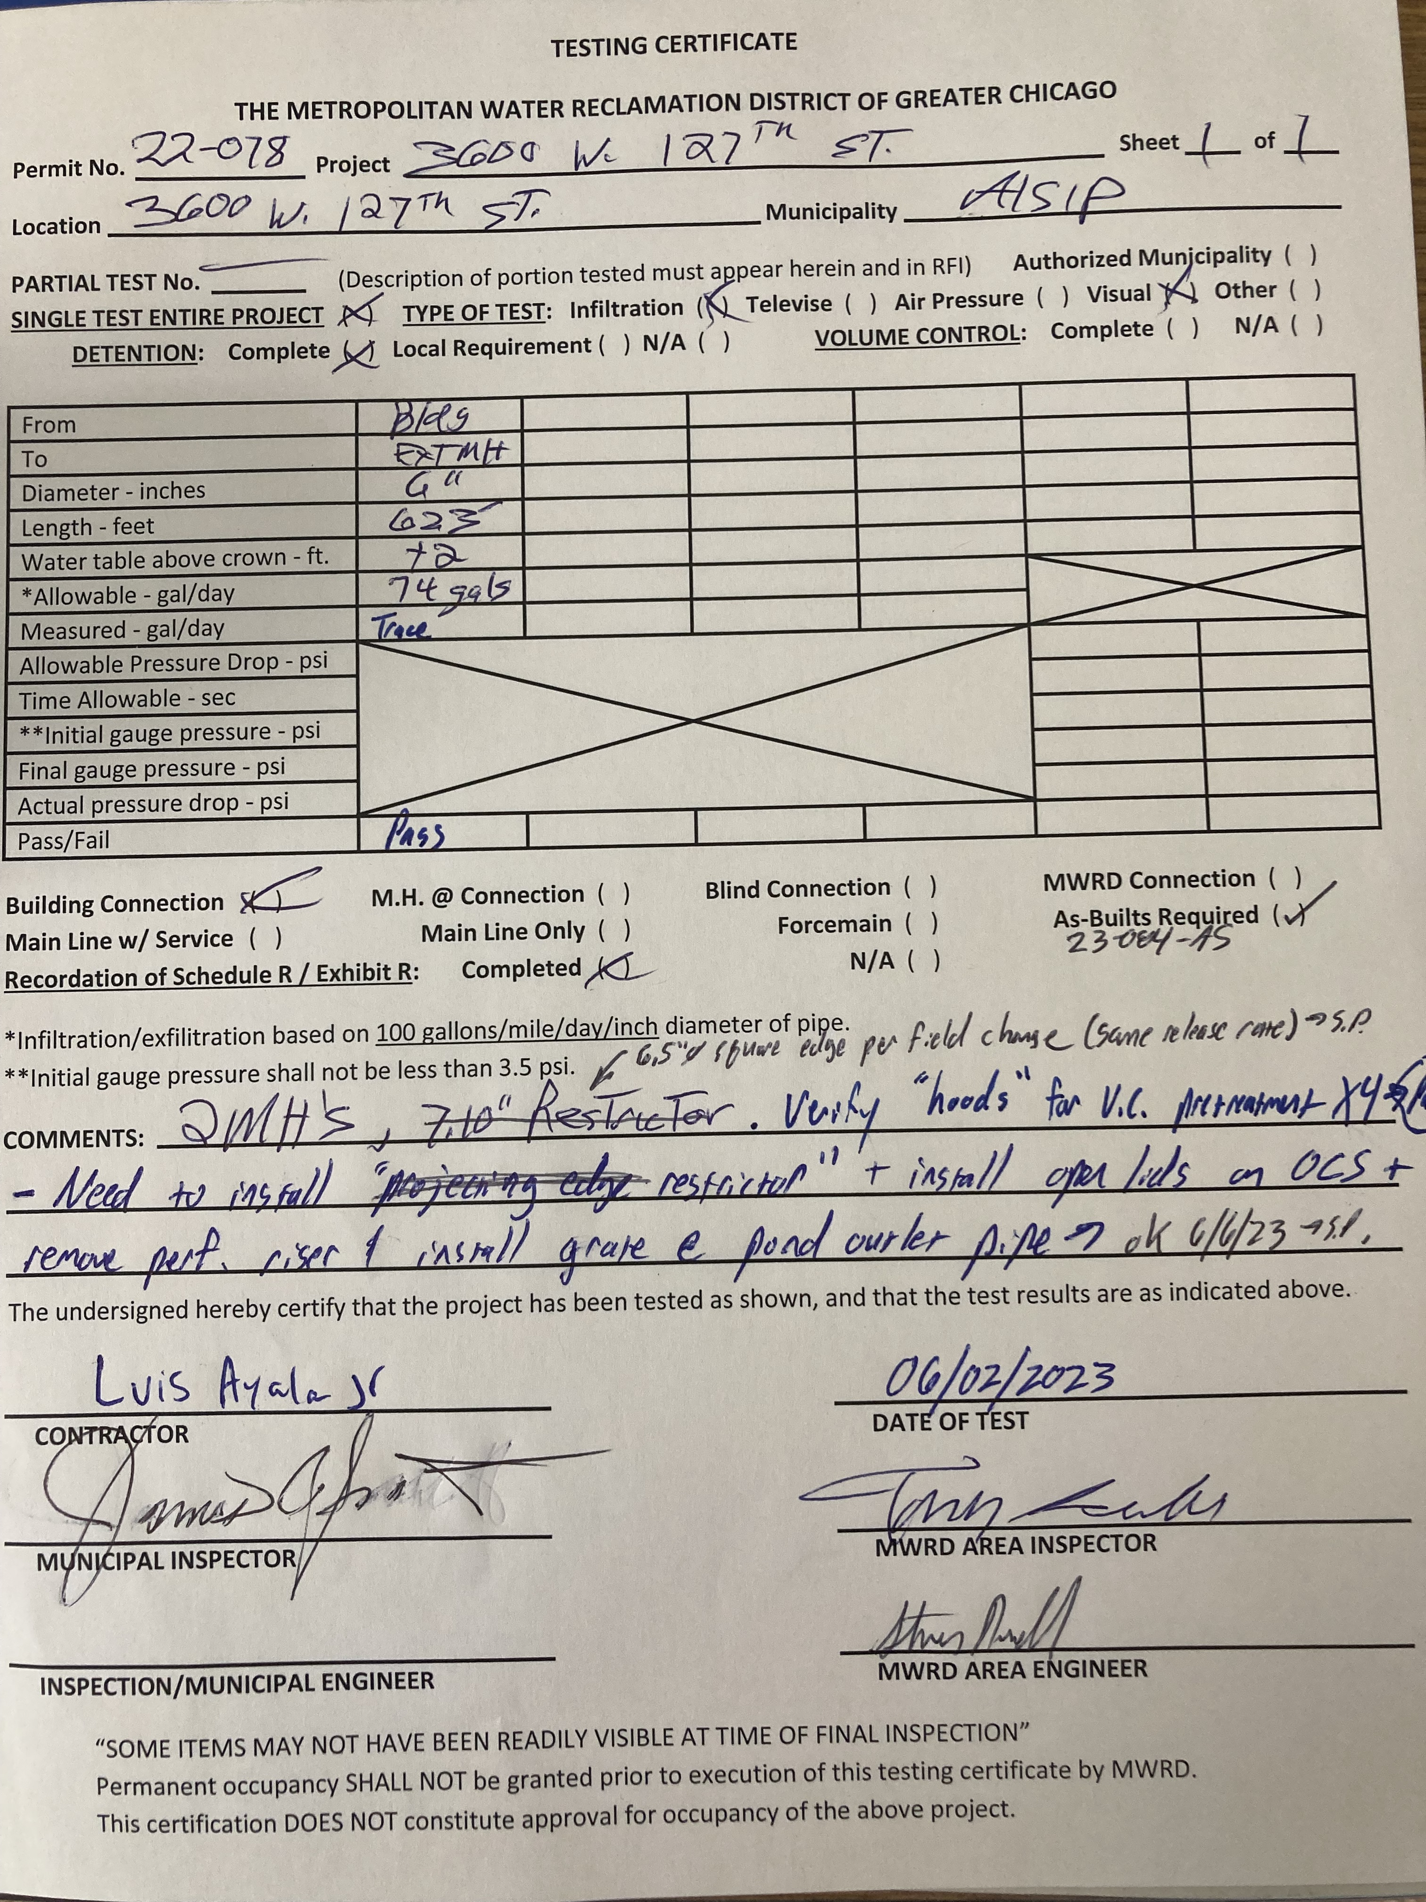
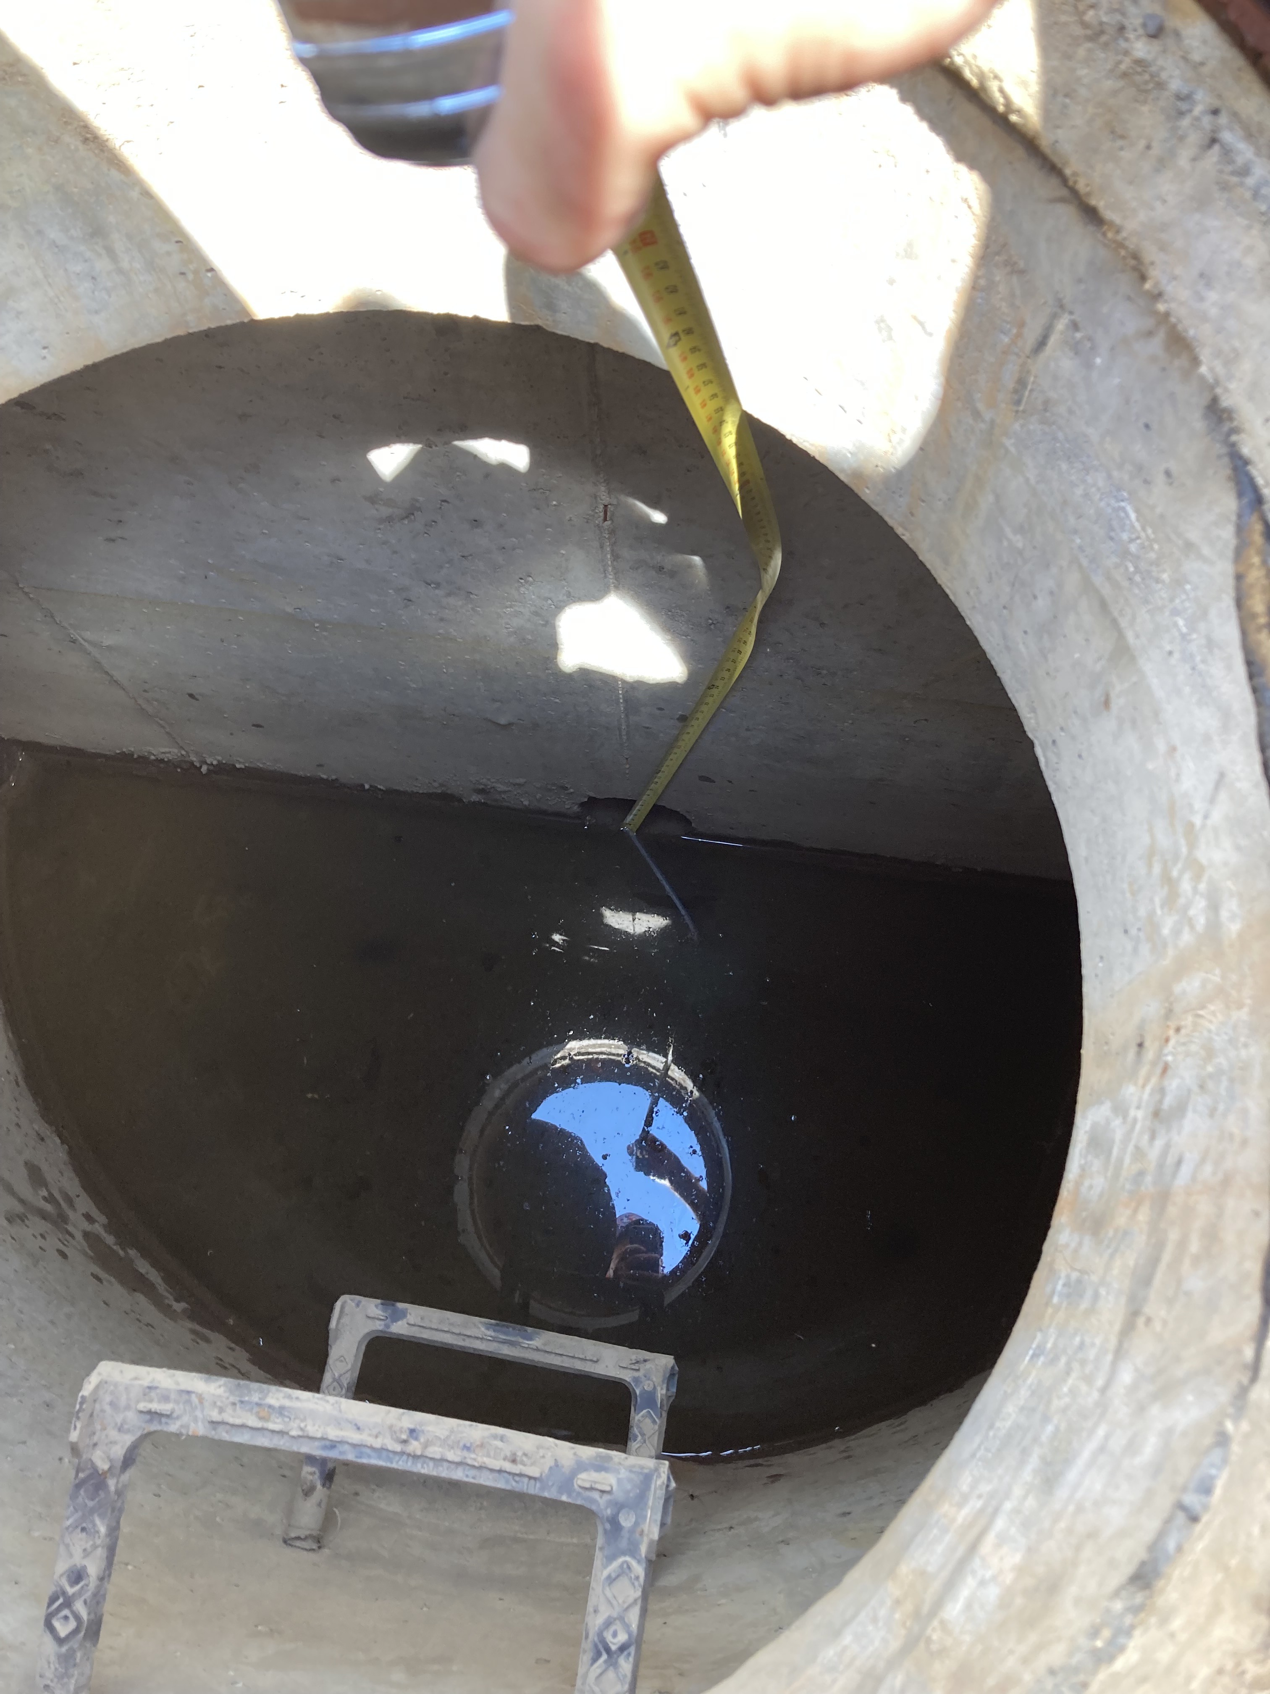

Slide 18
Changes to the plans after permit issuance
Notes:
Section Title

Slide 19
Field Changes
Minor changes
1. Examples: sewer alignment due to conflict, change of pipe material, type of backflow preventer, etc.
2. Alert the inspector to any potential field changes
  Inspector will review with Area Engineer for approval
3. Documentation of Village and Inspection Engineer approval also required
3. Ensure that full approval is obtained prior to proceeding with any field changes
4. Field changes shall be included on submitted Record Drawings
Notes:
Section Content

Slide 20
Permit Revisions
Major changes
1. Examples: changes to development area, change to stormwater management plan, change of receiving sewer, hazard areas, etc.
2. Submit the following documents to WMOInbox@mwrd.org for review/approval:
  Narrative explaining the proposed revisions
  Letter from the Village approving the revisions
  Revised plan sheets only (with stamp and signature)
  Revised permit pages only
  Any other supporting documents (calculations, etc.)
  Revision fees (if not fee exempt)
3. Do not proceed with proposed changes until permit revision is issued
Notes:
Section Content

Slide 21
Responsibilities of Municipalities
Notes:
Section Title

Slide 22
Tips to Stay in Compliance
Avoiding Violations
1. Inspections –don’t rely solely on the MWRD
  Remind developers of MWRD notification /requirements
2. Don’t allow construction to start without an issued MWRD Permit
3. Don’t issue mass grading permits before the WMO Permit is issued
  MWRD WMO Earthwork/Foundation Limited Permit
4. Don’t grant CO (Certificate of Occupancy) until the MWRD Testing Certificate has been issued
  It is extremely difficult to remedy construction deficiencies once the site is occupied and/or the contractor has been paid.
  It is extremely difficult to obtain required documentation (RFI, Record Drawings, Schedule R) once the site is occupied and/or the professional service contracts have been closed.
Notes:
Section Content

Slide 23
Benefits to Compliance
Working Together
Inspections are critical for buried infrastructure…how else can we know?
1. Soil Erosion Control
  Neighboring properties, clean public streets, downstream stormwater conveyance
2. Drainage
  Flooding complaints, protection of people and property
3. Sanitary Sewers
  Less maintenance, easier maintenance, approved piping arrangements
  I&I Reduction
Notes:
Section Content

Slide 24
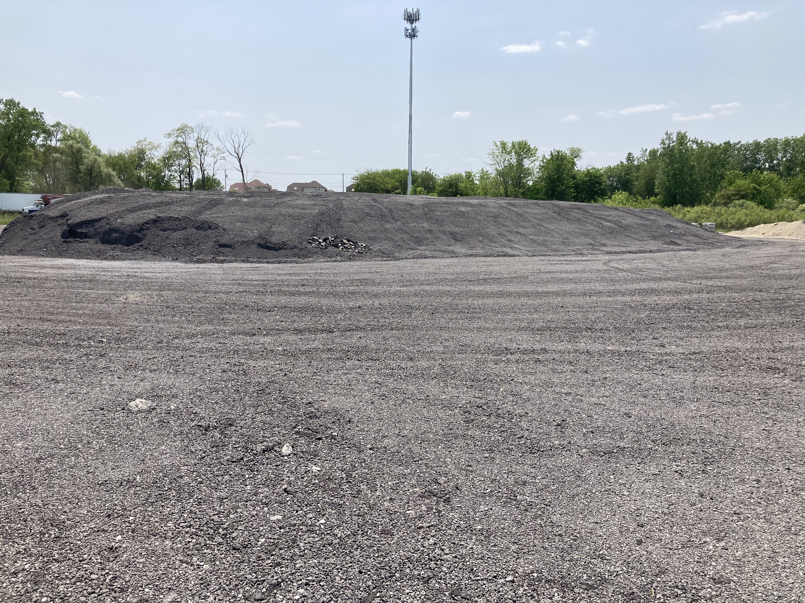
Asphalt Grindings for Truck Parking
Ongoing Challenge
The installation of “asphalt grindings” for vehicle parking DOES require an MWRD permit.
Notes:
Section Content

Slide 25
Where to go for Information
Notes:
Section Title

Slide 26
Useful Contacts
1. Permits under construction issues – assigned field inspector (708) 588-4055
2. Permit applications under review- assigned review engineer
3. Questions about permit applicability – Maureen Durkin (312) 751-3250, Dan Feltes (312) 751-3247
4. Questions about permit revisions – Adam Witek (312) 751-4449
5. Questions about permit determination letters – Constance Mihalache (312) 751-3248
6. Permit inquiries – Ann Gray (312) 751-3085
Notes:
Section Content

